Slide 1

Stock Market Prediction
Using Machine Learning

Slide 2

Agenda
Abstract
Introduction
Existing Methods
Proposed System
System Design
Implementation
Results and Discussions
Performance
Future Enhancements
Conclusion

Slide 3

Abstract
Time Series forecasting has been widely used to determine the future price of stock and
the analysis and modelling of finance time series importantly guide investors decision and trades
This work proposes an intelligent time series prediction system that uses Prophet optimization
for the purpose of prediction the price
The entire architecture of the stacked LSTM models for the predictive model will be built using the TensorFlow deep learning framework
The Proposed Model is a promising predictive technique for highly non linear time series whose patterns are difficult to capture by traditional models

Slide 4

Introduction
Financial markets are highly volatile and huge generate huge amounts of daily data
It is the most popular financial market instrument and its value changes quickly
Stock prices are predicted to determine the future value of companies stock or
other financial instruments that are marketed on financial exchange
However ,the stock market is influenced by many factors such as political events ,
economic conditions and traders expectation

Slide 5

What is Machine Learning
Machine Learning is the field of study that gives computers the ability
to learn without being explicitly programmed
More formally , it can defined as
A computer program is said to learn from experience E with respect to some class of task T and performance measure P ,if its performance at tasks in T as measured by P , improve with experice E
Example : playing Checkers.
E =the experience of playing many games of checkers
T = the task of playing checkers
P = the probability that the program will win the next game

Slide 6

Machine Learning in Stock Prediction
The field of Machine Learning is vast and plays a key role in a wide range of critical
application
We use the LSTM to predict the original price vs prediction price
The LSTM is a special kind of RNN which solve the short-term memory problem
Predicting the stock market involves predicting the closing prices of a company’s
stock for any given number of days ahead
We also plot the candlestick chat ,simple moving average ,Bollinger band plots

Slide 7

Existing Methods
Time Series forecasting consists of research area designed to solve various problem ,manly in the financial area
Prophet is a time-series forecasting library that is design for making forecasts for univariate time series dataset. It is fast and automated forecasts
The least squares support vector regression (LSSVR) algorithm is a further development of SVR and its use considerably reduces computational complexity and increases efficiency compared to standard SVR

Slide 8
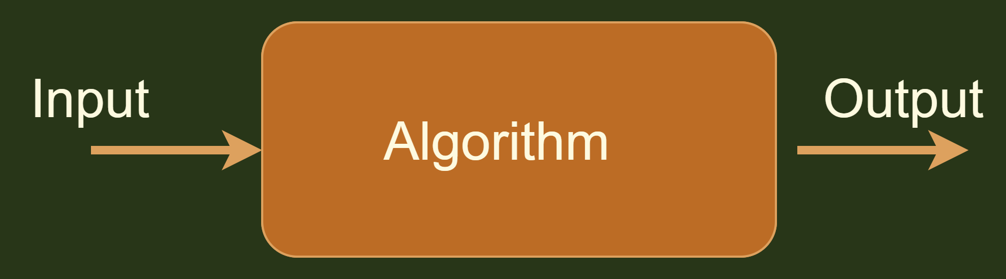
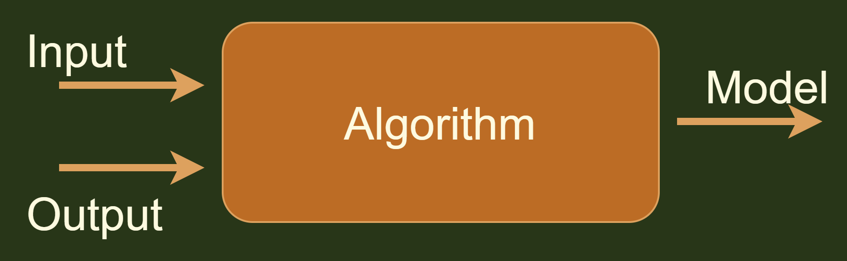
Software Development Process
Machine Learning Model Development

Slide 9

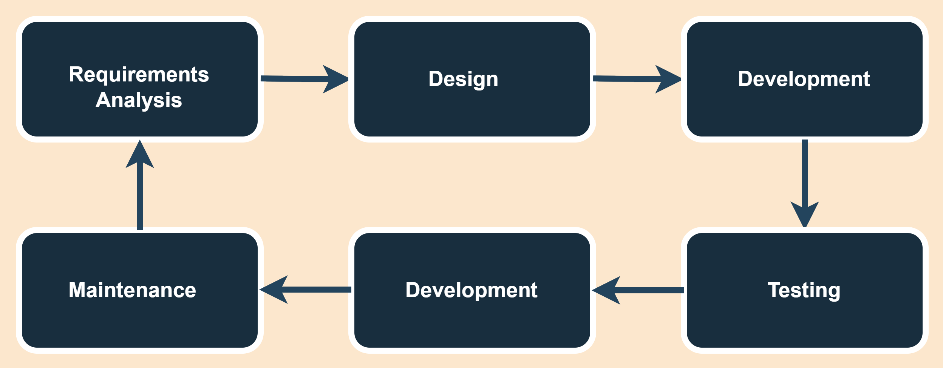
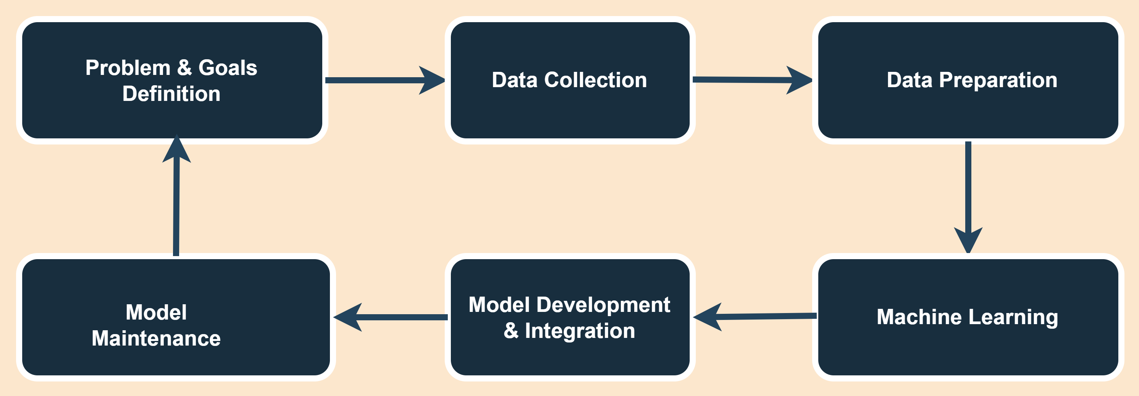
Traditional Software Development Lifecycle
Machine Learning Model Development Process

Slide 10
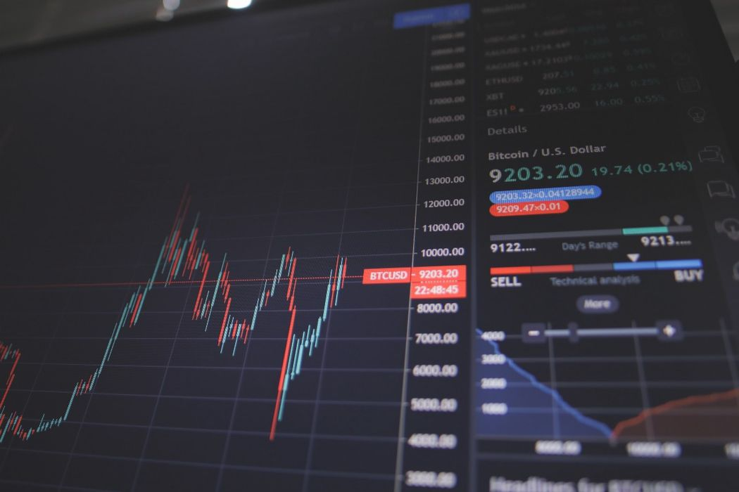
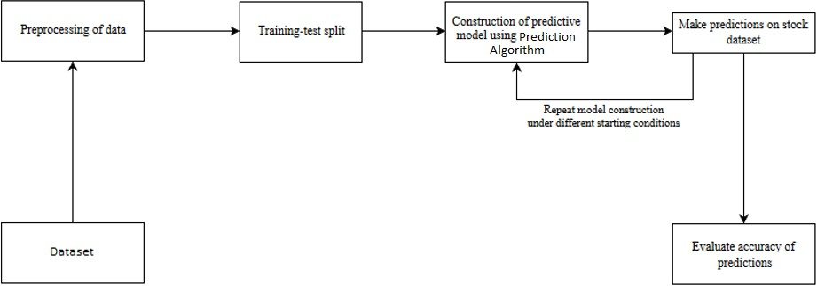
Pre-processing of data
Overall Architecture

Slide 11

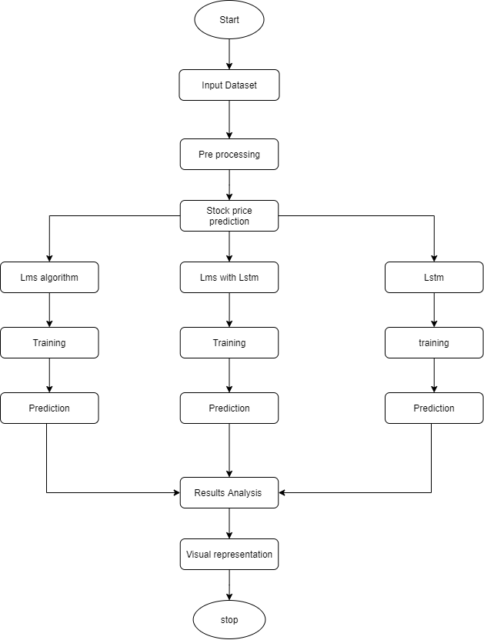
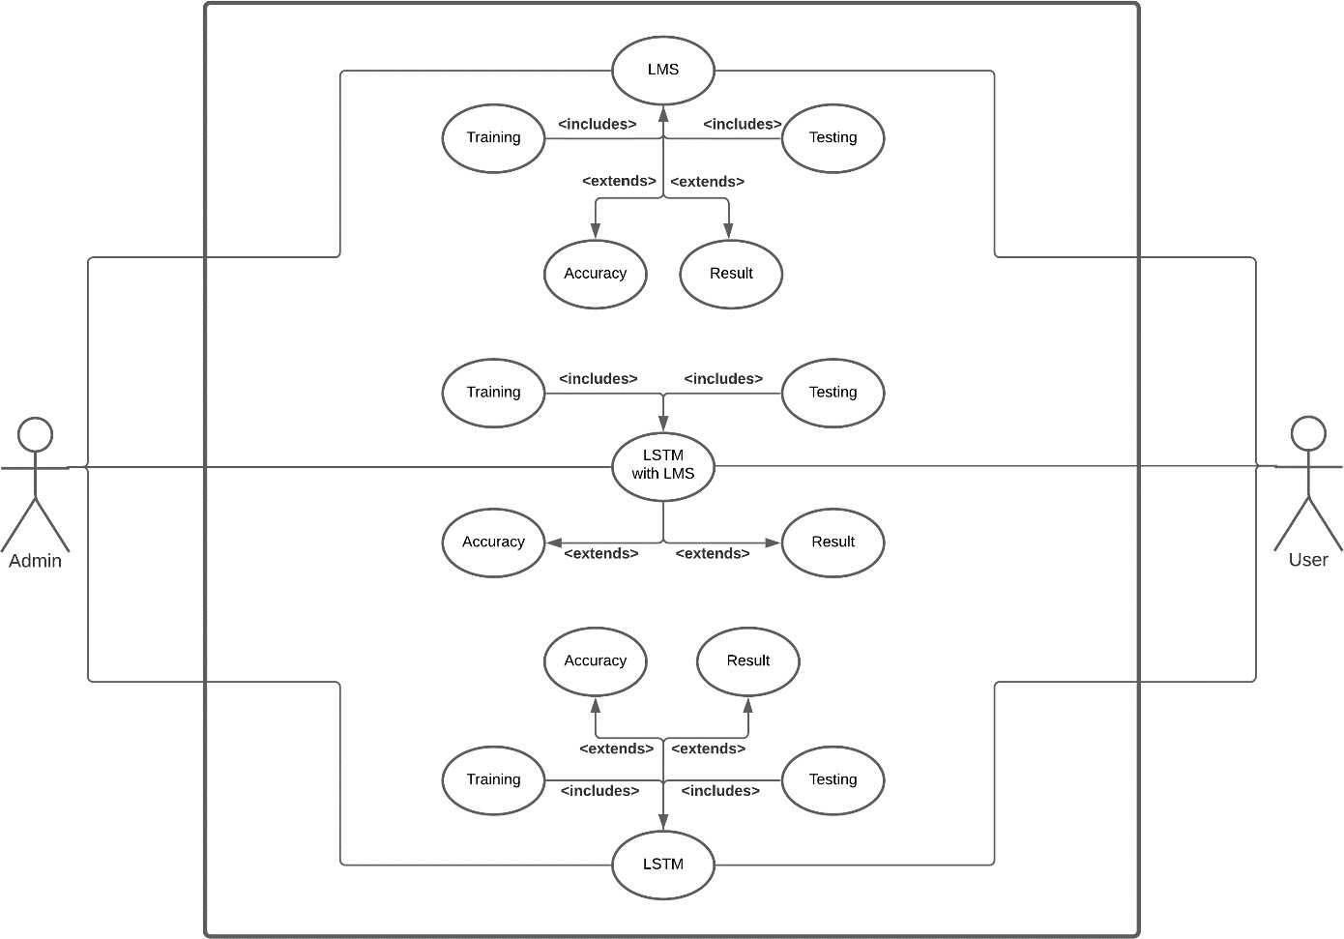
Use Case Diagram
Structure Chart

Slide 12
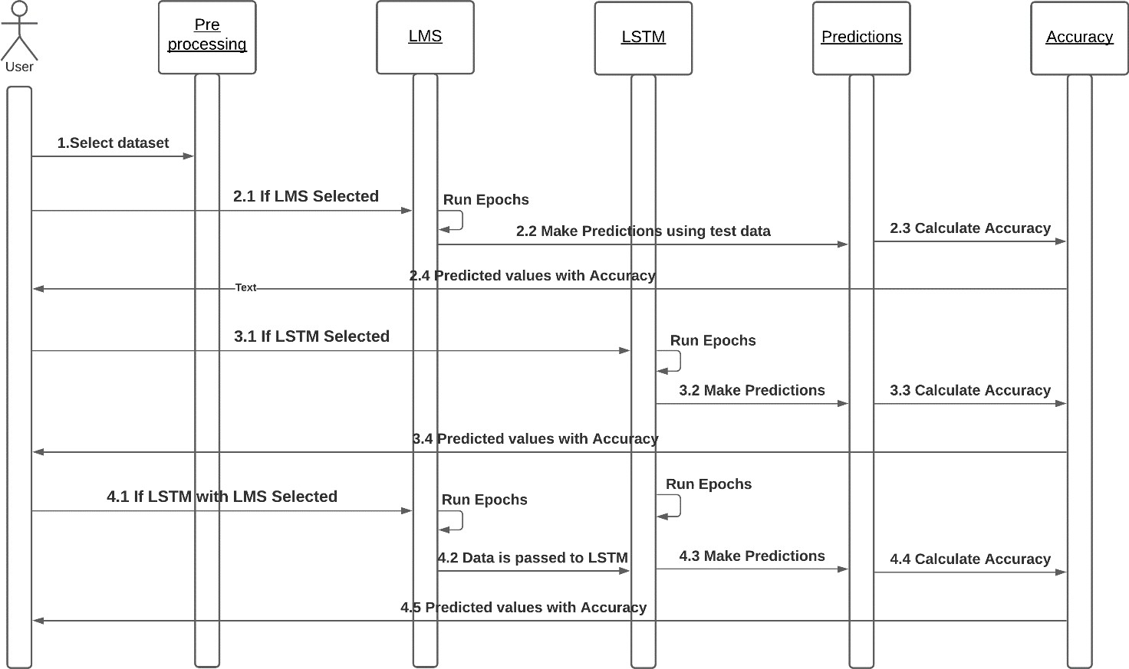
Sequence Diagram

Slide 13
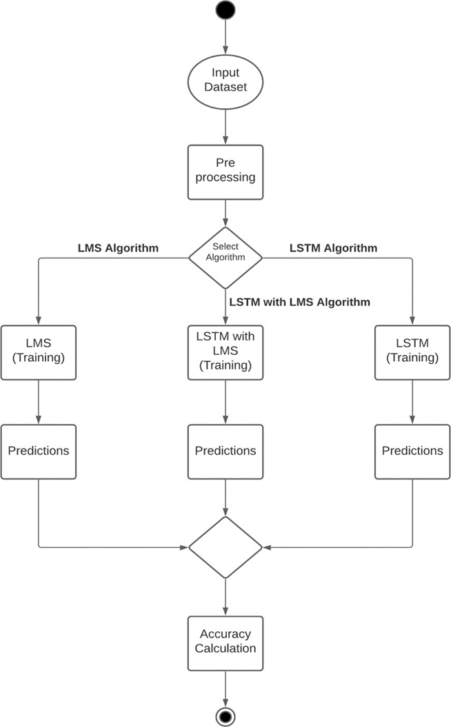
Activity Diagram

Slide 14
Proposed Methodology
The working is separated into three main stages :
Initial, Middle, Last Stages.
The Initial stage is identified with Data Exploration , Data Cleaning
and Data Transformation
The centre stage comprises of data modelling.,
The final stage comprises of data analysis using multiple models
Data exploration is similar to initial data analysis , visual exploration to
understand dataset and characteristics of the data

Slide 15
Proposed Methodology
Data cleaning is the process of detecting and correcting inaccurate records from record set , table or database to Identifying incomplete ,incorrect , inaccurate or irrelevant part of the data and the replacing , modifying
Data transformation is the process of converting data from one format to Another Typically from the format od source system into required format od destination system
Once the first stage is cleared then we move to data modelling.
Data modelling is the process of producing a descriptive diagram of relationships between various types of information that are to be stored in a database

Slide 16
Proposed Methodology
One of the goals of data modelling is to create the most efficient method
of storing information while still providing for complete access and reporting
After this the data is processed using algorithms and results are obtained.
This result are the test results generated by training the models on the train dataset
Once the dataset is processed then we can make use of the actual
dataset to predict stocks.

Slide 17
Architecture
Data Flow Diagram
Input : Company
Fetch Data
Train Model (LSSVR)
Plot Data
Predict Stock for n Days
Plot Predicted Results
Save Model

Slide 18
Disadvantages
The existing system focuses on the stock price market in Taiwan, but does not generalize for other markets worldwide
The system does not allow the import of raw day directly
The existing system cannot be used to analyse multi-variate time series
Lastly, the system does not have a user interface which can be distributed as a web app to users for personal use

Slide 19
Future Enhancement
LSTM just use a value very close to the previous day closing price as
prediction for the next day value. This is what would be expected by
a model that has no predictive ability.
The proposed model does not predict well for sudden changes in the trend
of stock data
This occurs due to external factors and real-world changes affecting the stock market
We can overcome this by implanting sentiment analysis and neural network to enhance
the proposed model
We can modify the same system to an online-learning system that adapts in real-time

Slide 20
Conclusion
Thus , as we can see above in our proposed method ,we train the data using
existing stock Dataset that is available .we can use this data to predict and
forecast the stock price of n-days into the future
The average performance of the model decreases with increase in
number of days to unpredictable change in trend
The current system can update its training set as each day passes so as to
detect newer trends and behave like an online-learning system
that predicts stock in real-time

